Slide 1


PowerPoint Training Module
September 2014
This document is proprietary in nature and is provided for the exclusive use of CAST personnel.
The contents are not to be shared with outside parties unless prior written consent is obtained from CAST Management Consultants, Inc.

Slide 2
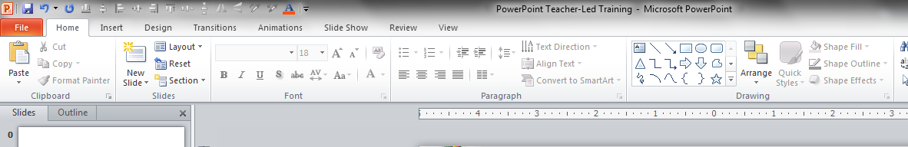
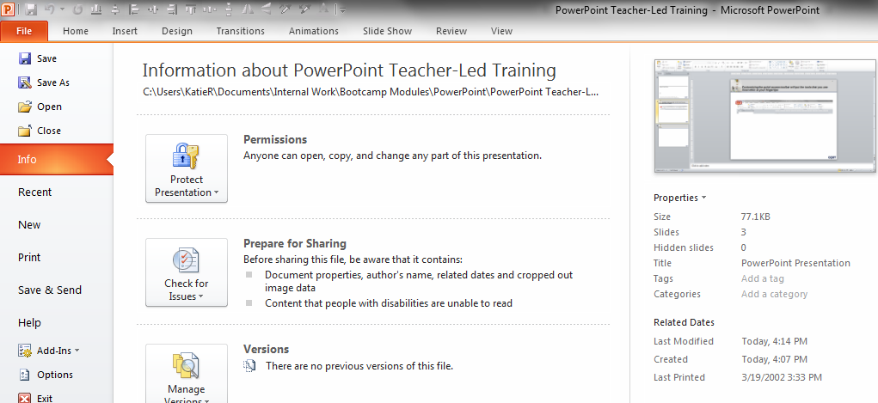
Customizing the Quick Access toolbar will put the tools that you use most often at your fingertips
Step 1: Select the File tab
Step 2: Select Options

Slide 3
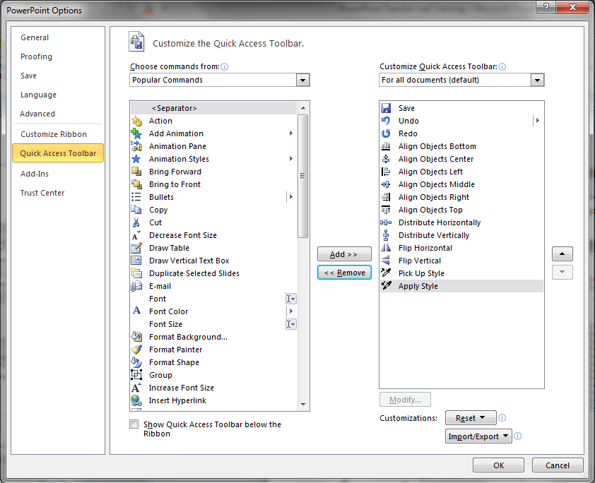
Customizing the Quick Access toolbar will put the tools that you use most often at your fingertips
Step 3: Select the Quick Access Toolbar
At minimum, the features shown below are recommended

Slide 4
Now, try out the tools that you have added to your Quick Access toolbar
ALIGN LEFT
ALIGN RIGHT

Slide 5
Now, try out the tools that you have added to your Quick Access toolbar
ALIGN TOP
ALIGN BOTTOM

Slide 6
Now, try out the tools that you have added to your Quick Access toolbar
ALIGN MIDDLE
ALIGN CENTER

Slide 7
Now, try out the tools that you have added to your Quick Access toolbar
DISTRIBUTE HORIZONTALLY
DISTRIBUTE VERTICALLY

Slide 8
Distribute the boxes diagonally as shown on the top part of the slide
DISTRIBUTE DIAGONALLY

Slide 9
Now, try out the tools that you have added to your Quick Access toolbar
FLIPPING SHAPES, THE FORMAT PAINTER, AND GROUPING
Flip Horizontally and Vertically
Pick
Up
Style
Apply
Style
Group the pyramid to the left, then move a copy to the right of this box.

Slide 10
Manipulating shapes is an important skill that you will use regularly
EXERCISES
COPYING AND RESIZING SHAPES
Copy Me
Using the shape in the top-left hand corner, complete the following exercises:
Copy and paste by selecting the shape, holding down the control button, and dragging the shape to another part of the slide
Copy and paste by selecting the shape, holding down the control AND shift buttons, and dragging the shape to another part of the slide
This keeps the new shape on the same horizontal or vertical plane as the original
Resize the shape while holding down the shift button
This maintains the aspect ratio

Slide 11
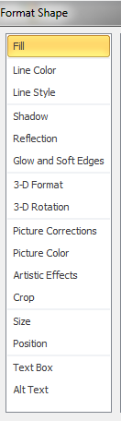
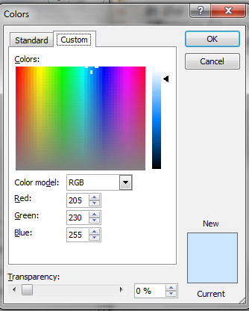
The “Format Shape” menu option contains several tools that allow you to customize a shape to fit your needs
CHANGING THE FILL COLOR AND STYLE
Solid Fill
CAST has preset colors that you will use to create a presentations
These are displayed in the color palettes in the MASTER slide template presentation
Use the custom color tab to specify the RGB settings for a color in the CAST palette
Gradients are common in CAST presentations and can be found in the MASTER presentation
Exercise: Change the fill of the shapes in the top-left hand corner. Change the top shape to a solid color in the CAST color palette and the bottom to a gradient fill taken from the MASTER slides.
Gradient Fill

Slide 12
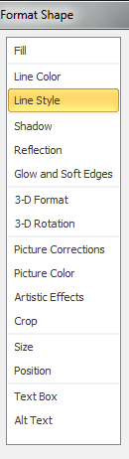
The “Format Shape” menu option contains several tools that allow you to customize a shape to fit your needs
CHANGING THE LINE COLOR AND LINE STYLE
Line Color is straightforward
See the MASTER presentation for common fill/ line color combinations
The Line Style feature allows you to adjust the line thickness and create dashed lines
Exercise: Change the outlines of the shapes in the left-hand side of the slide. Make changes to the line color, thickness, and dash type to explore the options.
Change Line Color
Change Line Thickness
Change to Dotted Line

Slide 13
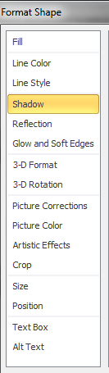
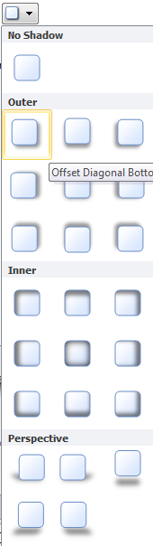
The “Format Shape” menu option contains several tools that allow you to customize a shape to fit your needs
CHANGING THE SHADOW, REFLECTION, AND GLOW AND SOFT EDGES
Add a Shadow
The most common shadow setting is the first choice in the Outer category
Tip: If you have screenshots or images in your presentation, be sure to add a shadow
The Reflection and Glow and Soft Edges options are not as commonly used in CAST presentations
Exercise: Add a shadow to the shape in the top-left-hand corner

Slide 14
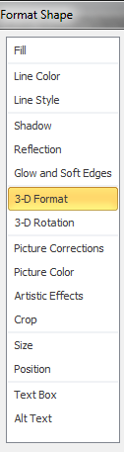
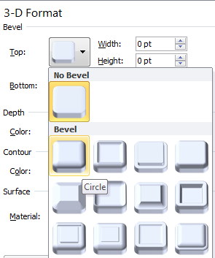
The “Format Shape” menu option contains several tools that allow you to customize a shape to fit your needs
CHANGING THE 3-D FORMAT AND 3-D ROTATION
3-D Formatting is common in CAST presentations
The first Bevel effect is the most frequently used of the 3-D Format features
3-D Rotation is not as common
Exercise: Add a bevel effect to the shape in the top-left hand corner. Also experiment with other effects.
Beveled Effect

Slide 15

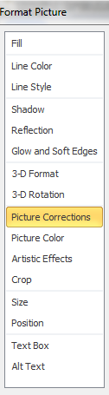
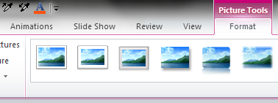
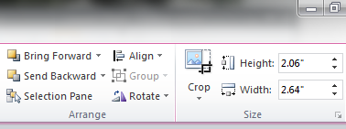
The “Format Shape” menu option contains several tools that allow you to customize a shape to fit your needs
CHANGING THE PICTURE FEATURES
These options allow you to optimize a picture for you presentation
The function you will use most often is the Crop option
This is especially useful to focus on one part of a screenshot
Exercise: Use the picture in the top-left hand corner to experiment with the different effects in Picture Corrections, Picture Color, and Artistic Effects
Exercise: Crop out one of the puppies. First, use the Crop option in the Format Shape menu. Next, try the Crop function on the ribbon
Exercise: Take a screenshot and crop out the section of your choice
Find the Crop Function on the Ribbon

Slide 16
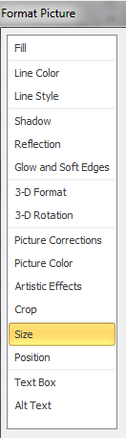
The “Format Shape” menu option contains several tools that allow you to customize a shape to fit your needs
CHANGING THE SIZE AND POSITION
Use the Size feature to ensure that corresponding shapes are equal sizes
The Position feature gives the exact location of the shape on the slide and allows for minute adjustments
These adjustments are often smaller than you can make with mouse or arrow buttons
These features are especially useful when you have corresponding shapes on different slides
Exercise: Using the Size and Position options, align the top shape to the center of the master shape and the bottom shape to the middle of the master shape. Also, make each equally sized.
Align Center
Master Shape
Align Middle

Slide 17
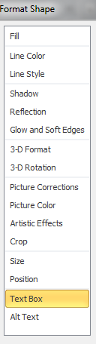
The “Format Shape” menu option contains several tools that allow you to customize a shape to fit your needs
CHANGING THE TEXT BOX FEATURES
Sample Text Sample Text Sample Text Sample Text Sample Text Sample Text
Sample Text Sample
Text Sample Text
Sample Text Sample
Text Sample Text
These features allow you to specify the vertical alignment and direction of text within a shape
Autofitting the shape to the textbox causes a shape to change size each time you modify text
This feature should usually be disabled
Shrinking the internal margins and unwrapping the text opens up more room in a shape
Exercise: Change the text box settings in the box in the upper-left so that all the text fits. Try to do this without looking at the settings on the second box
Exercise: Change the arrow in the bottom-left hand corner to match the arrow to its right
Sample Text
Sample Text

Slide 18
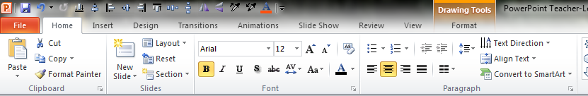
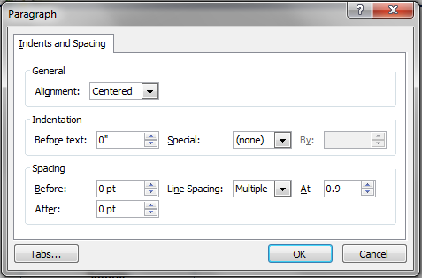
Additions text box tools can be found on the ribbon…
CHANGING THE TEXT BOX FEATURES
Sample
Sample
Sample
Sample
Sample
Sample
Sample
Sample
Sample
Sample
Sample
Sample
Sample
Sample
Sample
Sample
Sample
Sample
Sample
Sample
Sample
Sample
Sample
Sample
Adjust the spacing to add more content
Line Spacing must be at least 0.9

Slide 19
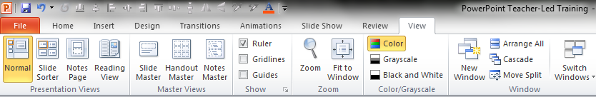

Other tips and tricks that will help you make the most of PowerPoint…
Inserting and Exporting Shapes
The shapes at your disposal include arrows, flow charts, and call-outs
These are best exported as pictures
Exercise: Insert the shape of your choice to the right. Then copy and paste it to the next slide as a picture.
Layering Shapes
Shapes can be moved backwards or forwards for proper layering
MOVE BACKWARD
MOVE
FORWARD
Alignment Tools
Guides and gridlines are useful for aligning shapes on a slide
Cascading Titles
The top line of a title should be shorter than the bottom line

Slide 20
APPENDIX:
TABLES AND CHARTS

Slide 21
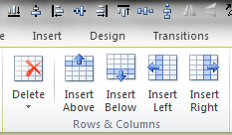
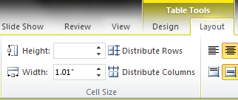
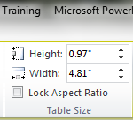
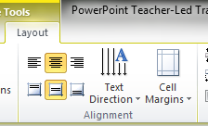
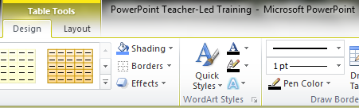
Formatting tables in PowerPoint is important skill that you will use to present data-heavy recommendations
TABLE SIZE
Area | New | Old
Local | 1,793 | 822
Gov. | 1,437 | 659
Central | 1,352 | 722
District | 1,667 | 837
Region | 1,578 | 663
Int’l | 1,437 | 985
TEXT FEATURES
CELL BORDERS
Step 1: Select
Table Area
3
2
Step 2: Select Border Style
Step 3: Select
Borders to Add

Slide 22
Creating charts in PowerPoint is made simpler because the data is stored within the presentation
Exercise: Rename the categories in the chart. Hint: Look under Chart Design tab on the ribbon
Exercise: Change the color of one series. Hint: Use your knowledge of formatting shapes
Exercise: Move the legend to the right of the chart. Hint: Look under Chart Layout tab on the ribbon

